Slide 1


Ohood Soliman
T5 Bootcamp - Data Science

Slide 2
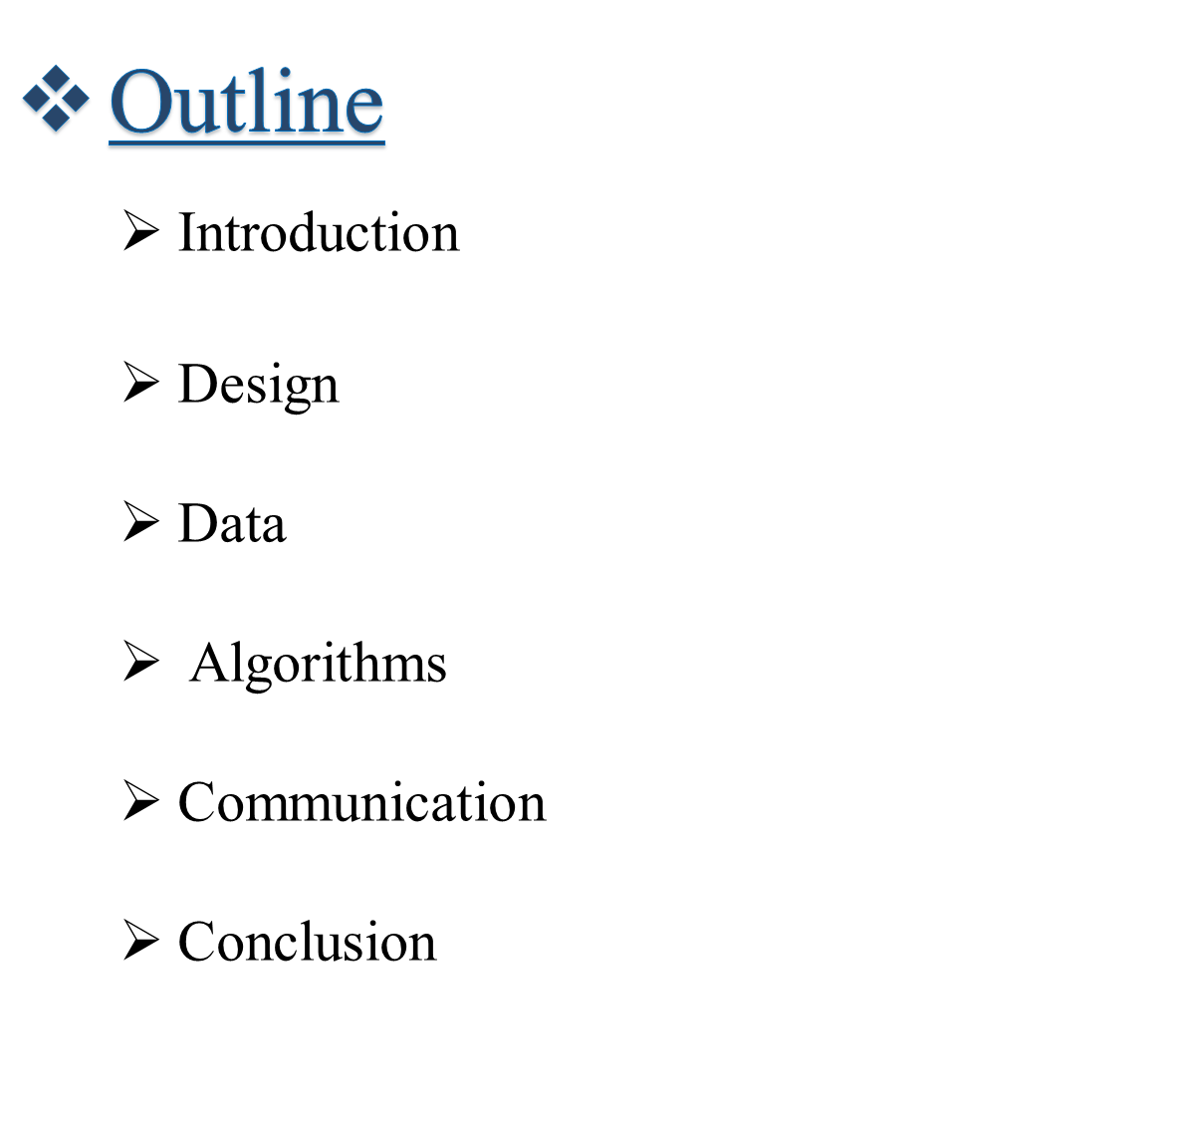

T5 Bootcamp - Data Science

Slide 3

The main goal of this project is to understand the basic concepts of data science, know when and how to apply Exploratory Data Analysis on a data set.
Therefore, it was important to collect a dataset from any open data resources and explore it by using common EDA techniques and tools.
T5 Bootcamp - Data Science

Slide 4

The most common types of crimes
Show the frequencies of crimes change over the day? week? Year?
Clarify the day with the highest number of crimes
The most dangerous places in Boston
T5 Bootcamp - Data Science

Slide 5

Kaggle.com
The dataset "Crimes in Boston" were used in this project, provided by" Boston Police Department
It contains about 316K Rows and 16 columns
Records begin in June 14, 2015 and continue to September 3, 2018.
T5 Bootcamp - Data Science

Slide 6

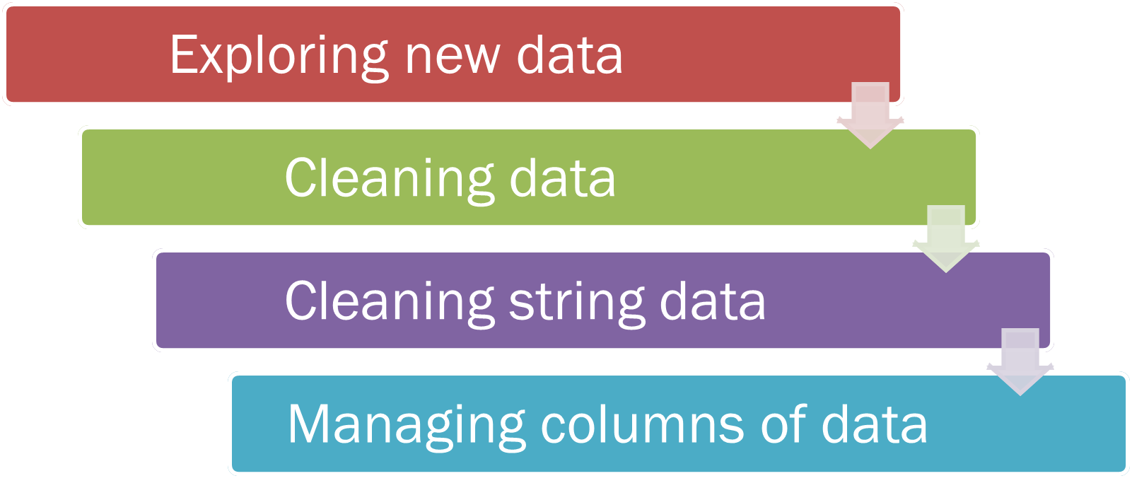
T5 Bootcamp - Data Science

Slide 7

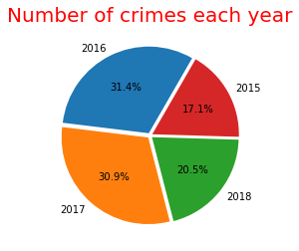
T5 Bootcamp - Data Science

Slide 8
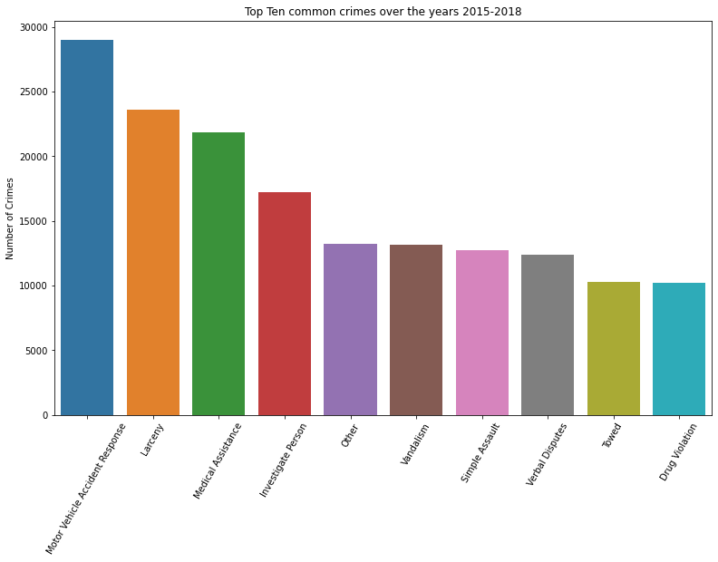
T5 Bootcamp - Data Science

Slide 9
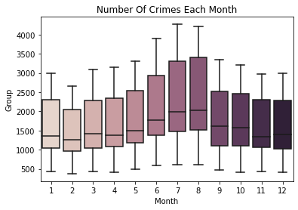
T5 Bootcamp - Data Science

Slide 10
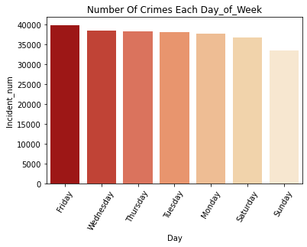
T5 Bootcamp - Data Science

Slide 11
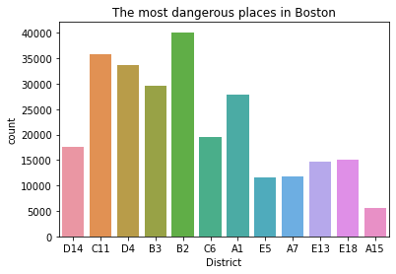
T5 Bootcamp - Data Science

Slide 12

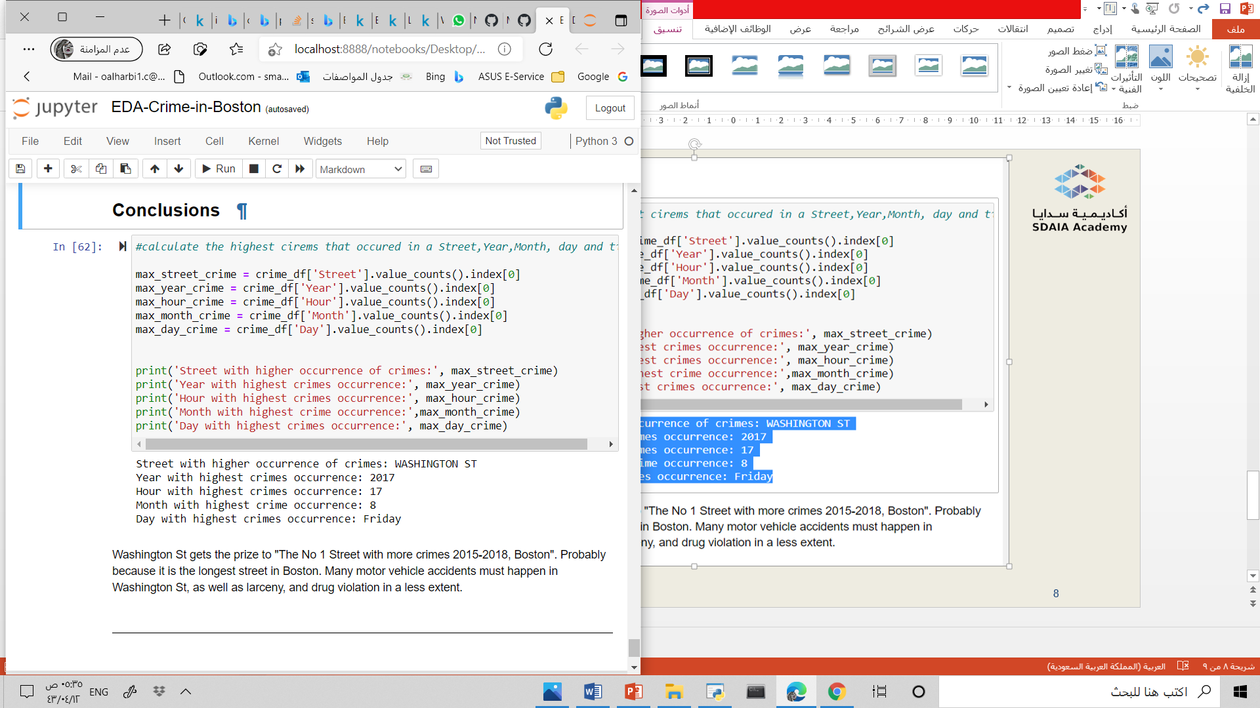
T5 Bootcamp - Data Science

Slide 13

T5 Bootcamp - Data Science

